Slide 1
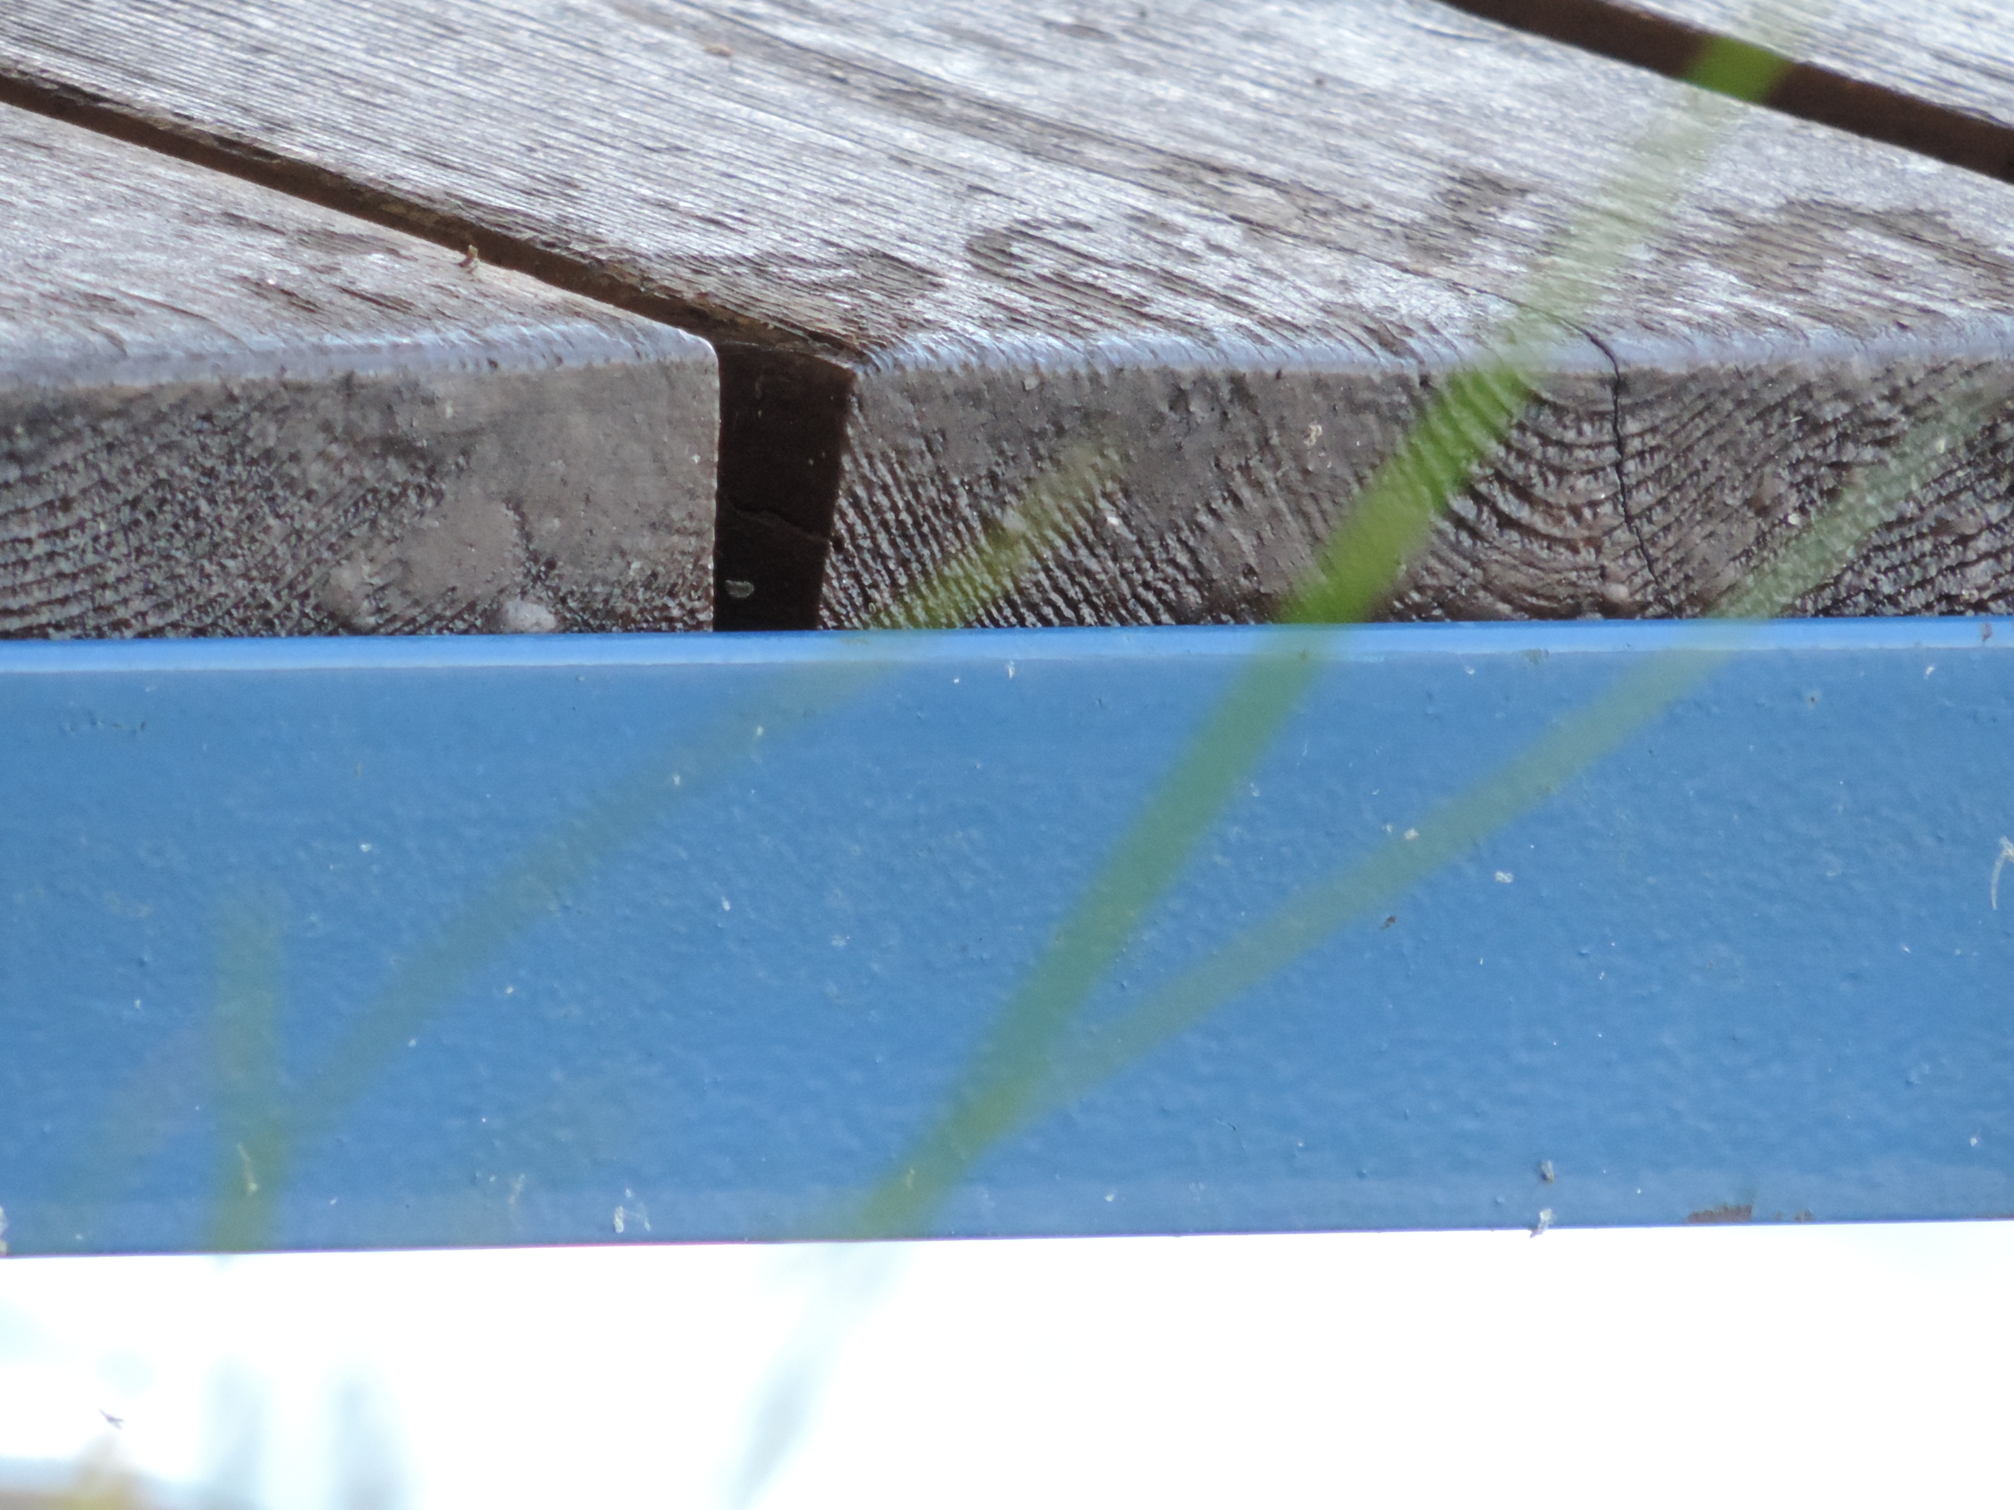
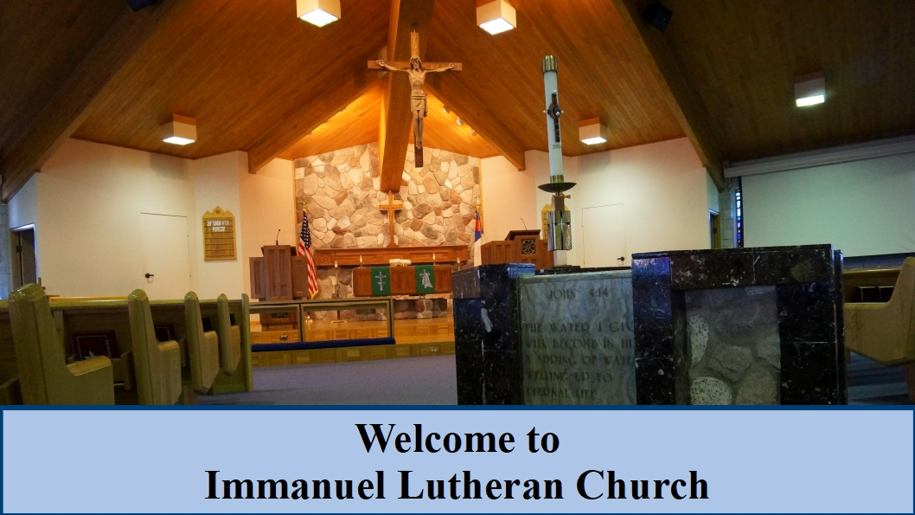
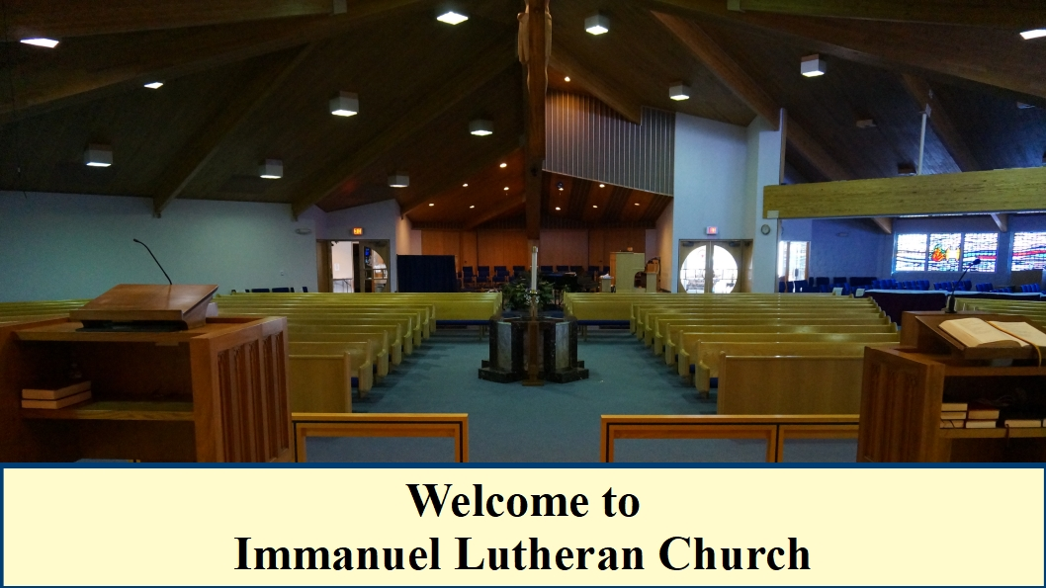
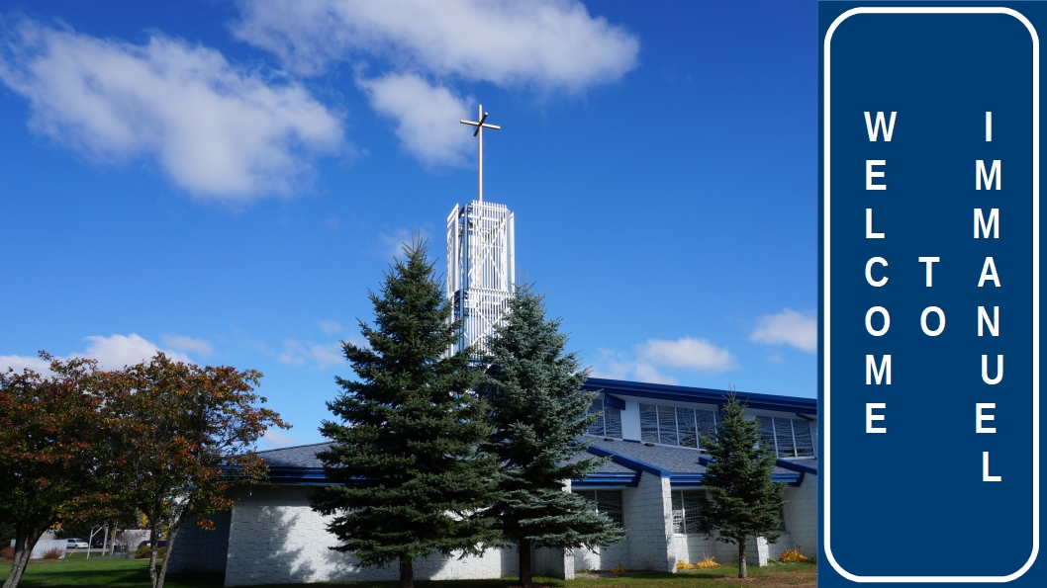
Welcome to
Immanuel Lutheran Church!
We are happy to have you join us
in worship today.

Slide 2



Slide 3
COMMUNION ACCESSIBILITY
We try to accommodate
everyone who worships with us at Immanuel.
If for any reason
you are unable to commune at the altar,
please inform an usher,
and we will bring communion to you.

Slide 4



GIVE A SMILE
SHAKE A HAND

Slide 5
B
I
B
L
E
S
T
U
D
Y
“FOLLOW”
Jesus only issues an invitation to relationship, that begins with a simple request: “Follow Me”.
Pastor Al Kersten leads this DVD/ workbook based study by Andy Stanley, as we journey follow Jesus through the Gospels.
The study begins at 9:15 a.m.
Check the bulletin for the location.

Slide 6
B
I
B
L
E
S
T
U
D
Y
“ROOTED IN THE PREEMINENT CHRIST”
A new study begins
Sunday, March 3 at 9:15 a.m.
This discussion based study will go through
St. Paul’s letter to the Colossians!
The study is led by Pastor Erickson.
See the bulletin for details.

Slide 7
B
I
B
L
E
S
T
U
D
Y
“PEW SISTERS”
Join Amy Schultz, Monday evenings
at 6:00 P.M. in the church library.
This study tells what God has done,
and is still doing in the lives of women
in the church today.

Slide 8
B
I
B
L
E
S
T
U
D
Y
“JOURNEY THROUGH GENESIS”
This study meets in the adult ed room Thursday mornings at 10:00 A.M.
Join Pastor Schultz
for this continuing study
in the book of Genesis.

Slide 9
B
I
B
L
E
S
T
U
D
Y
“VILLAGE PEOPLE BIBLE STUDY”
This study entitled,
“REVELATION BLITZ”,
meets Thursdays at 2:00 P.M.
in the adult education room.
Pastor Erickson is the class leader.

Slide 10

Do you need the PRAYER CHAIN?
Contact Kristine Ball
at 356-9316

Slide 11

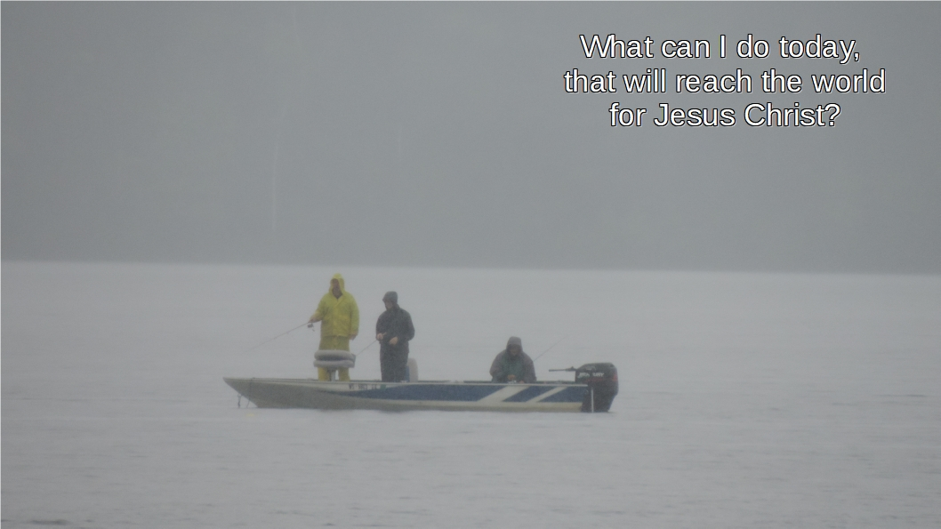
Visitation Evangelism meets
Thursday at 9:30 A.M.
in Pastor Erickson’s office.

Slide 12
DO YOU ENJOY SINGING?
Join the Adult Choir!
They meet Thursdays
at 6:30 PM.

Slide 13

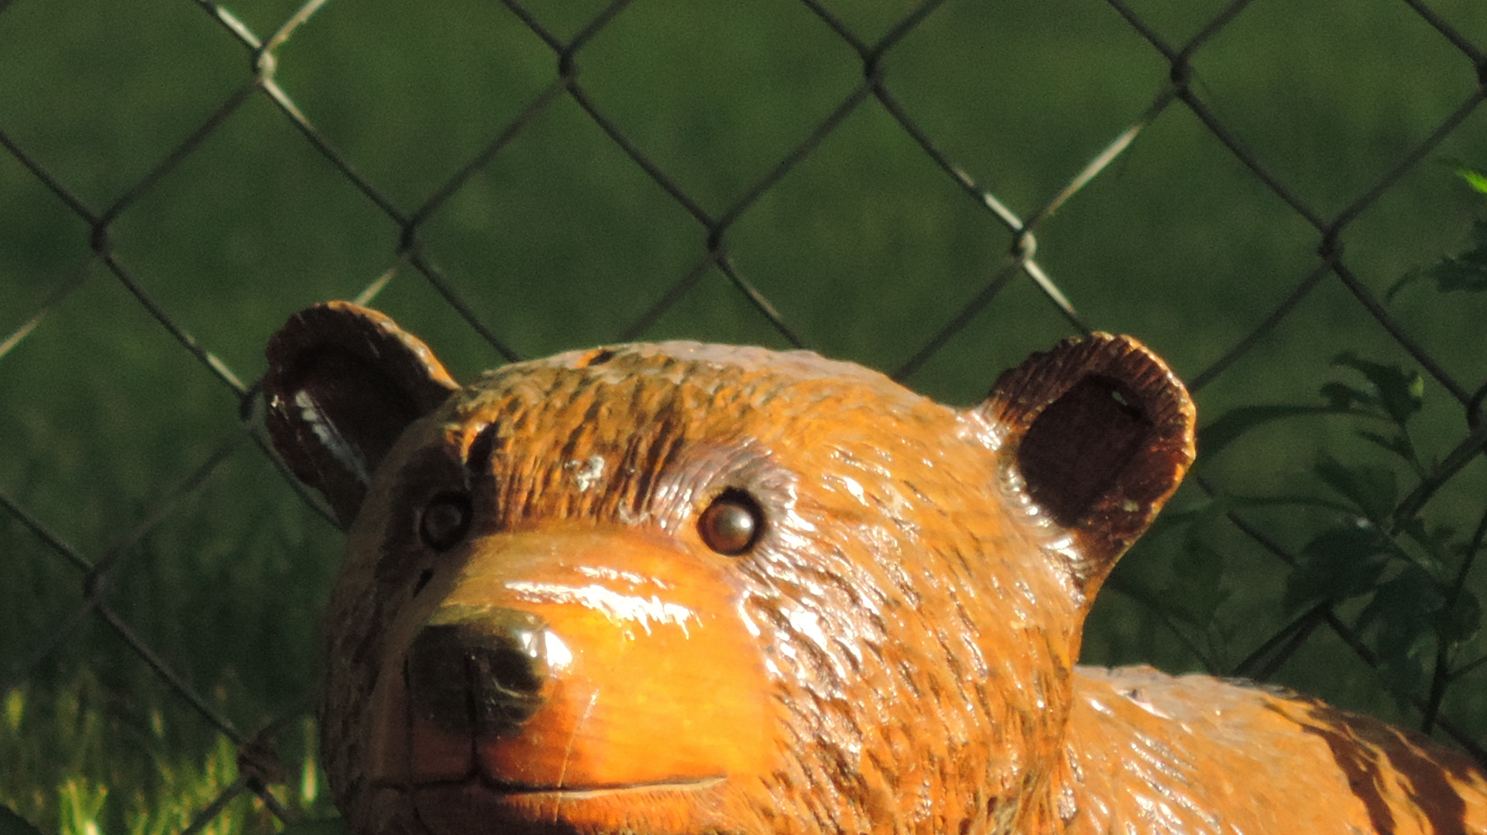
YOUTH GROUP
THURSDAYS at 6:30 p.m.
for Grades 7-12 and College-age
Image by N. Hoch

Slide 14
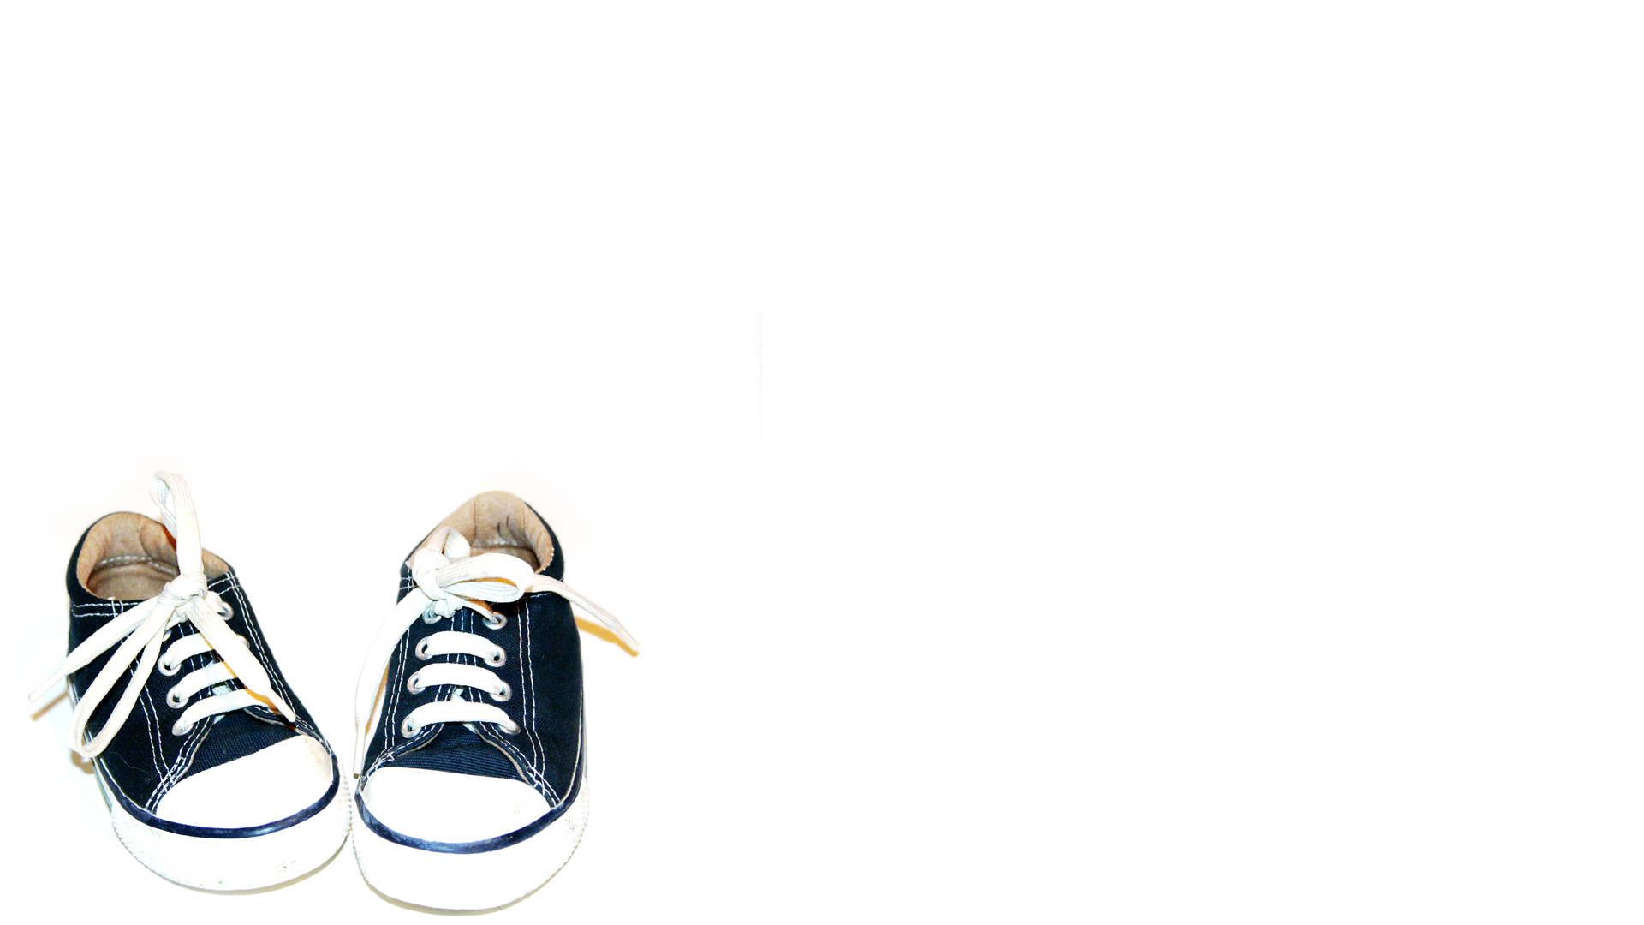
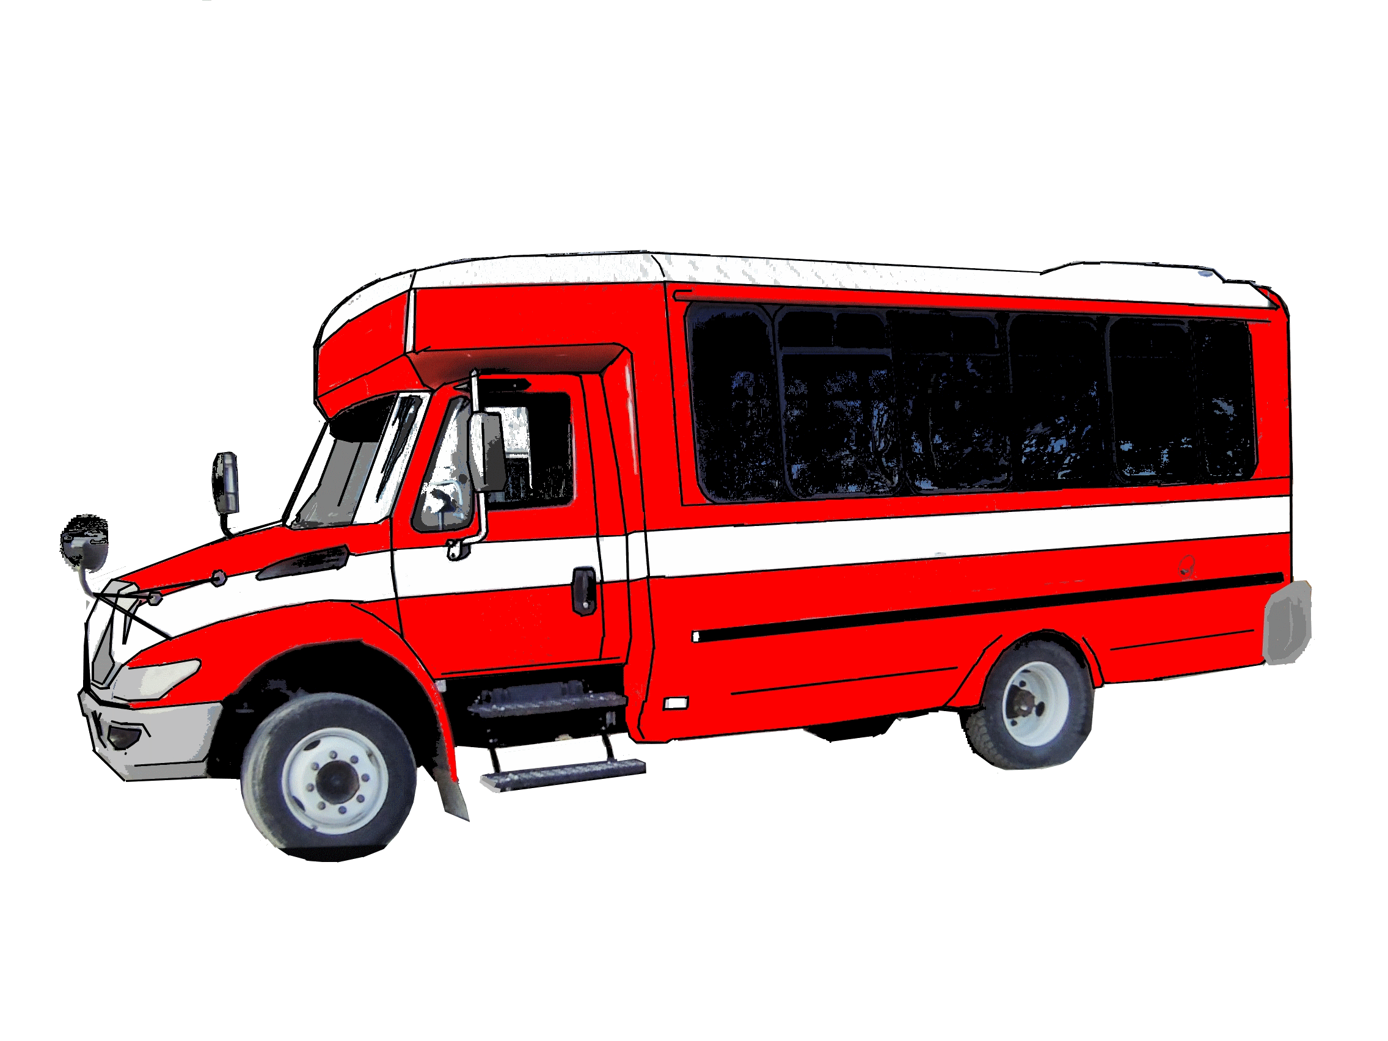
DO YOU NEED A RIDE TO CHURCH?
The Board of Social Ministry
provides free rides on Dial-a-Ride
to and from our 10:30 Sunday services.
Contact Dave Meyer
for information at 354-5864.

Slide 15
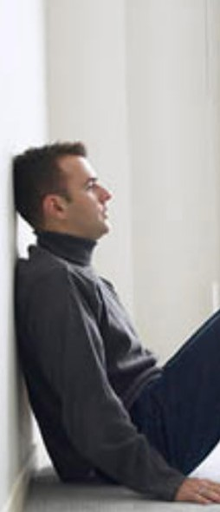

The new 13 week session meets
Tuesdays at 6:00 P.M.
in the Youth Room.
Please contact Carol Boyd (354-3758)
or Dave Meyer (354-5864)
for more information.

